Slide 1

Math's 2
Basic equations, sequences and functions.

Slide 2
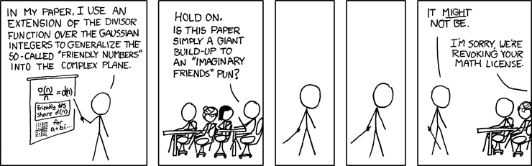
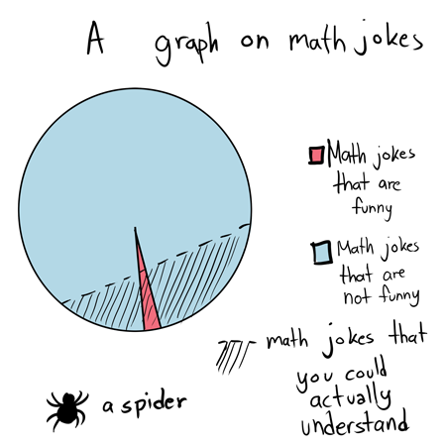
Mathematical functions and equations.

Slide 3
Linear Equations
Linear equations are some of the most recognisable and widely used equations in science
They take the form:
y=mx + c
It allows you to pull out the coordinates of a straight line

Slide 4
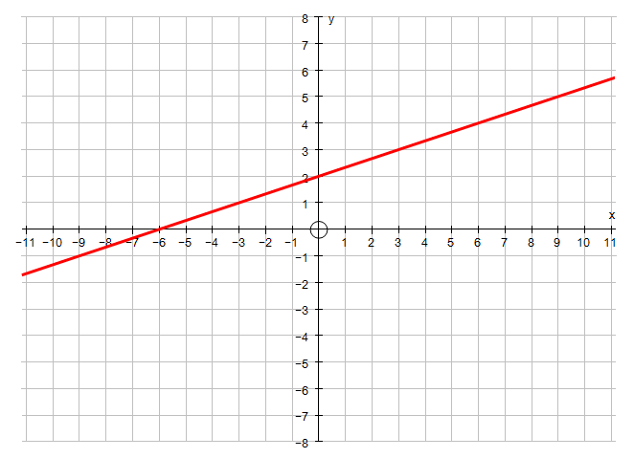
Linear Equations
y
c
m
x

Slide 5
Linear Equations
y
=
+
c
m
x

Slide 6
Linear Equations
Often you know parts of a linear equation and want to determine what the others are.
This is just a very simple algebraic equation like we have been doing!

Slide 7
Linear Equations
Lets start with the a line where we know that at x coordinate 4 it is at y coordinate 7 and the line crosses the y axis at coordinate 1.

Slide 8
Linear Equations
Lets start with the a line where we know that at x coordinate 4 it is at y coordinate 7 and the line crosses the y axis at coordinate 1.
The equation would be
7 = m*4 + 1

Slide 9
Linear Equations
Lets start with the a line where we know that at x coordinate 4 it is at y coordinate 7 and the line crosses the y axis at coordinate 1.
The equation would be
7 = m*4 + 1
We want to find the gradient of this line. In much of science this is a critical part of statistics

Slide 10
Linear Equations
7 = m*4 + 1

Slide 11
Linear Equations
6 = 4m

Slide 12
Linear Equations
m = 1.5

Slide 13
Linear Equations
m = 1.5
Lets look at this then

Slide 14
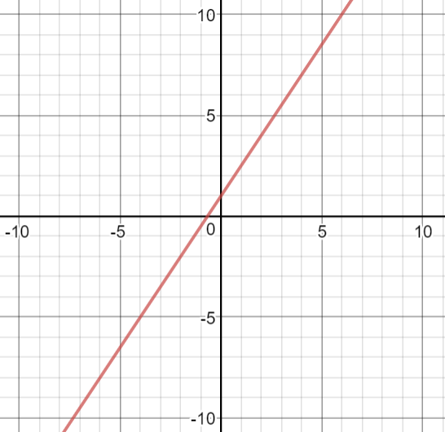
Linear Equations
y = 1.5x + 1
Lets look at this then

Slide 15
Linear Equations
Now you try and find the y intercept (c) of this one.
y = 0.6 x + c
Where
x= 5
y= 3

Slide 16
Linear Equations
Now you try and find the y intercept (c) of this one.
3 = 0.6 * 5 + c

Slide 17
Linear Equations
Now you try and find the y intercept (c) of this one.
3 = 3 + c

Slide 18
Linear Equations
Now you try and find the y intercept (c) of this one.
c = 0

Slide 19
Quadratic Equations
Quadratic equations are those which include a power higher than 1 in the equation.
This causes something funky to happen to our graphs.

Slide 20
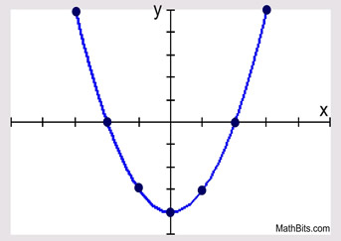
Quadratic Equations
Quadratic equations are those which include a power higher than 1 in the equation.
This causes something funky to happen to our graphs.

Slide 21
Quadratic Equations
Quadratic equations are those which include a power higher than 1 in the equation.
This causes something funky to happen to our graphs.
Not so linear anymore!

Slide 22
Quadratic Equations
These equations take the form:
ax² + bx + c = 0

Slide 23
Quadratic Equations
These equations take the form:
ax² + bx + c = 0
Solving these can be done in several ways and we have already covered one of them – factorising.

Slide 24
Quadratic Equations
These equations take the form:
ax² + bx + c = 0
Solving these can be done in several ways and we have already covered one of them – factorising.

Slide 25
Quadratic Equations
Lets look at the equation:
x² – 9x + 20 = 0

Slide 26
Quadratic Equations
Lets look at the equation:
x² – 9x + 20 = 0
Factorise it!

Slide 27
Quadratic Equations
Lets look at the equation:
x² – 9x + 20 = 0
(x – 4)(x - 5)= 0

Slide 28
Quadratic Equations
Lets look at the equation:
x² – 9x + 20 = 0
(x – 4)(x - 5)= 0
Now we solve each bracket for 0 to get the two answers to the quadratic equation

Slide 29
Quadratic Equations
Lets look at the equation:
x² – 9x + 20 = 0
(x – 4) = 0 and (x - 5)= 0
Now we solve each bracket for 0 to get the two answers to the quadratic equation

Slide 30
Quadratic Equations
Lets look at the equation:
x² – 9x + 20 = 0
x = 4 or x = 5
Now we solve each bracket for 0 to get the two answers to the quadratic equation.
These answers are called the roots – in graphical terms these are where the line touches the x axis.

Slide 31
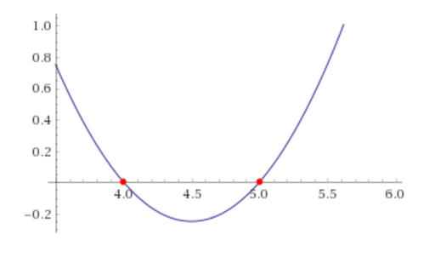
Quadratic Equations
Lets look at the equation:
x² – 9x + 20 = 0
x = 4 or x = 5
These answers are called the roots – in graphical terms these are where the line touches the x axis.

Slide 32
Quadratic Equations
We’ve learnt another way of solving quadratic equations inside factoring:
Completing the square

Slide 33
Quadratic Equations
Completing the square:
x² + 6x -2 = 0

Slide 34
Quadratic Equations
Completing the square:
x² + 6x -2 = 0
If you remember complete the square we can make X² + 6x into (x + 3)² -9 .

Slide 35
Quadratic Equations
Completing the square:
x² + 6x -2 = 0
(x + 3)² – 11 = 0

Slide 36
Quadratic Equations
Completing the square:
x² + 6x -2 = 0
(x + 3)² = 11

Slide 37

Quadratic Equations
Completing the square:
x² + 6x -2 = 0
x + 3 = $√$11

Slide 38

Quadratic Equations
Completing the square:
x² + 6x -2 = 0
x + 3 = $3.3$

Slide 39
Quadratic Equations
Completing the square:
x² + 6x -2 = 0
x = 0.3

Slide 40

Quadratic Equations
Completing the square:
x² + 6x -2 = 0
But! x + 3 = -$3.3$ as well

Slide 41

Quadratic Equations
Completing the square:
x² + 6x -2 = 0
x + 3 – 3 = $−3.3$ – 3

Slide 42
Quadratic Equations
Completing the square:
x² + 6x -2 = 0
x = -6.3

Slide 43
Quadratic Equations
Completing the square:
so
x² + 6x -2 = 0
x = -6.3
Or
x = 0.3

Slide 44
Quadratic Equations
There is another way to solve quadratic equations called the quadratic formula.
This is a plug and play formula where you put in the values from the equation and get an answer.
Probably the simplest way to be honest.

Slide 45
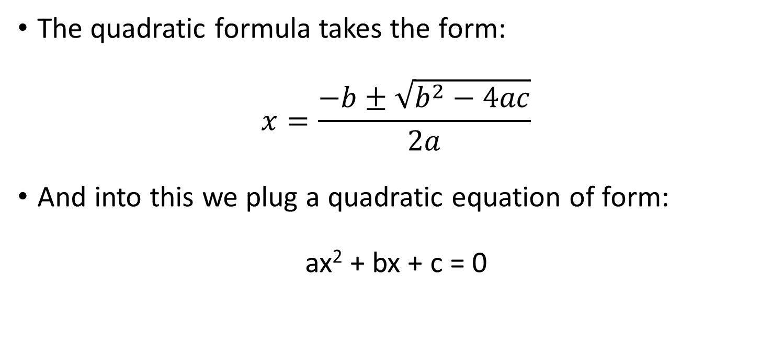
Quadratic Equations
The quadratic formula takes the form:
$$x=\frac{−b±\sqrt{b^{2}−4ac}}{2a}$$
And into this we plug a quadratic equation of form:
ax² + bx + c = 0

Slide 46

Quadratic Equations
Lets try the formula:
$$x=\frac{−b±\sqrt{b^{2}−4ac}}{2a}$$
Put this equation into it
2x² - 5x - 6 = 0

Slide 47

Quadratic Equations
Lets try the formula:
$$x=\frac{−5±\sqrt{{−5}^{2}−4∗2∗6}}{2 ∗2}$$
Put this equation into it
2x² - 5x - 6 = 0

Slide 48

Quadratic Equations
Lets try the formula:
$$x=\frac{5±\sqrt{25−−48}}{4}$$
Put this equation into it
2x² - 5x - 6 = 0

Slide 49

Quadratic Equations
Lets try the formula:
$$x=\frac{5±\sqrt{73}}{4}$$
Put this equation into it
2x² - 5x - 6 = 0

Slide 50

Quadratic Equations
Lets try the formula:
$$x=\frac{5±8.54}{4}$$
Put this equation into it
2x² - 5x - 6 = 0

Slide 51

Quadratic Equations
Lets try the formula: so
$x=\frac{5+8.54}{4}$ or $x=\frac{5−8.54}{4}$
Put this equation into it
2x² - 5x - 6 = 0

Slide 52

Quadratic Equations
Lets try the formula: so
$x=3.385$ or $x=−0.885$
Put this equation into it
2x² - 5x - 6 = 0

Slide 53
Simultaneous Equations
When you have an equation with multiple unknown variables there can be an infinite number of solutions.
x + 2y = 20
x = 2
y = 4
Or
x = 4
y = 3
etc

Slide 54
Simultaneous Equations
But if you have two equations with the same variables it becomes possible to solve them both
If you have 3 variables you need 3 equations etc.

Slide 55
Simultaneous Equations
Lets look at:
3x + y = 11
2x + y = 8
The most common way of solving these is elimination. But this requires that one unknown has the same coefficient in both equations.

Slide 56
Simultaneous Equations
Lets look at:
3x + y = 11
2x + y = 8
The most common way of solving these is elimination. But this requires that one unknown has the same coefficient in both equations.

Slide 57
Simultaneous Equations
Lets look at:
3x + y = 11
2x + y = 8
The first step is to subtract the equations from one another so that you remove y entirely.

Slide 58
Simultaneous Equations
Lets look at:
3x + y = 11
- -
2x + y = 8
The first step is to subtract the equations from one another so that you remove y entirely.

Slide 59
Simultaneous Equations
Lets look at:
3x + y = 11
- -
2x + y = 8
x = 3

Slide 60
Simultaneous Equations
Lets look at:
3x + y = 11
2x + y = 8
Now sub x = 3 into one of the equations

Slide 61
Simultaneous Equations
Lets look at:
3 x 3 + y = 11
Now sub x = 3 into one of the equations

Slide 62
Simultaneous Equations
Lets look at:
9 + y = 11
Now sub x = 3 into one of the equations

Slide 63
Simultaneous Equations
Lets look at:
y = 2
Now sub x = 3 into one of the equations

Slide 64
Simultaneous Equations
Lets look at:
3x + y = 11
2x + y = 8
x = 3
y = 2

Slide 65
Simultaneous Equations
What happens if the coefficients aren’t the same?
Make it so they are!
3x + 2y = 17
4x + y = 30

Slide 66
Simultaneous Equations
3x + 2y = 17
4x - y = 30
Multiply all of one equation to make equal coefficients

Slide 67
Simultaneous Equations
3x + 2y = 17
(4x - y = 30) x2
Multiply all of one equation to make equal coefficients

Slide 68
Simultaneous Equations
3x + 2y = 17
8x - 2y = 60
Multiply all of one equation to make equal coefficients

Slide 69
Simultaneous Equations
3x + 2y = 17
8x - 2y = 60
Now subtract or add the equations so one term cancels out.
In this case we need to add them together as y is negative in the second equation.

Slide 70
Simultaneous Equations
3x + 2y = 17
+ + +
8x - 2y = 60

Slide 71
Simultaneous Equations
3x + 2y = 17
+ + +
8x - 2y = 60
11x = 77

Slide 72
Simultaneous Equations
3x + 2y = 17
+ + +
8x - 2y = 60
x = 7

Slide 73
Simultaneous Equations
3x + 2y = 17
8x - 2y = 60
Now sub x = 7 back in

Slide 74
Simultaneous Equations
3 * 7 + 2y = 17
Now sub x = 7 back in

Slide 75
Simultaneous Equations
21 + 2y = 17
Now sub x = 7 back in

Slide 76
Simultaneous Equations
2y = -4
Now sub x = 7 back in

Slide 77
Simultaneous Equations
y = -2
Now sub x = 7 back in

Slide 78
Simultaneous Equations
3x + 2y = 17
8x - 2y = 60
x = 7
y = -2

Slide 79
Simultaneous Equations
We can apply this technique to a linear equation as we saw before
When we know two coordinates on the line we can work out both the gradient and the intercept

Slide 80
Simultaneous Equations
We can apply this technique to a linear equation as we saw before
Say we have two coordinates
7 = 2m + c
20 = 6m + c

Slide 81
Simultaneous Equations
We can apply this technique to a linear equation as we saw before
Say we have two coordinates
7 = 2m + c
- - -
20 = 6m + c

Slide 82
Simultaneous Equations
We can apply this technique to a linear equation as we saw before
Say we have two coordinates
7 = 2m + c
- - -
20 = 6m + c
13 = 4m

Slide 83
Simultaneous Equations
We can apply this technique to a linear equation as we saw before
Say we have two coordinates
7 = 2m + c
- - -
20 = 6m + c
13 = 4m
m = 3.25

Slide 84
Simultaneous Equations
We can apply this technique to a linear equation as we saw before
Say we have two coordinates
7 = 2 x 3.25 + c

Slide 85
Simultaneous Equations
We can apply this technique to a linear equation as we saw before
Say we have two coordinates
7 = 2 x 3.25 + c
c = 7 – 6.5

Slide 86
Simultaneous Equations
We can apply this technique to a linear equation as we saw before
Say we have two coordinates
7 = 2 x 3.25 + c
c = 0.5

Slide 87
Simultaneous Equations
We can apply this technique to a linear equation as we saw before
So we can now make a full generic equation for that line.
y = 3.25x + 0.5

Slide 88
Simultaneous Quadratic Equations
Sometimes quadratic equations can have multiple terms in them and you have to solve these as well.
This combines our previous solving of quadratic equations and solving simultaneous equations.

Slide 89
Simultaneous Quadratic Equations
Lets look at these simultaneous equations
y = x + 3
y = x² + 3x

Slide 90
Simultaneous Quadratic Equations
Lets look at these simultaneous equations
y = x + 3
y = x² + 3x
When we look at this we see that we can substitute y for
x + 3 or x² + 3x

Slide 91
Simultaneous Quadratic Equations
Lets look at these simultaneous equations
y = x + 3
x + 3 = x² + 3x

Slide 92
Simultaneous Quadratic Equations
Lets look at these simultaneous equations
y = x + 3
x + 3 = x² + 3x
Now we can rearrange it into a quadratic equation.

Slide 93
Simultaneous Quadratic Equations
Lets look at these simultaneous equations
y = x + 3
x + 3 = x² + 3x
Now we can rearrange it into a quadratic equation.
x² + 2x – 3 = 0

Slide 94
Simultaneous Quadratic Equations
Lets look at these simultaneous equations
y = x + 3
x + 3 = x² + 3x
Now we can rearrange it into a quadratic equation.
x² + 2x – 3 = 0
Factorise it

Slide 95
Simultaneous Quadratic Equations
Lets look at these simultaneous equations
y = x + 3
x + 3 = x² + 3x
Now we can rearrange it into a quadratic equation.
x² + 2x – 3 = 0
Factorise it
(x + 3)(x – 1) = 0

Slide 96
Simultaneous Quadratic Equations
Lets look at these simultaneous equations
y = x + 3
x + 3 = x² + 3x
So
x = -3
Or
x = 1

Slide 97
Simultaneous Quadratic Equations
Lets look at these simultaneous equations
y = x + 3
So
x = -3
Or
x = 1
Now sub these values into the original equation.

Slide 98
Simultaneous Quadratic Equations
Lets look at these simultaneous equations
y = -3 + 3

Slide 99
Simultaneous Quadratic Equations
Lets look at these simultaneous equations
y = -3 + 3
y = 0

Slide 100
Simultaneous Quadratic Equations
Lets look at these simultaneous equations
y = 1 + 3

Slide 101
Simultaneous Quadratic Equations
Lets look at these simultaneous equations
y = 1 + 3
y = 4

Slide 102
Simultaneous Quadratic Equations
Lets look at these simultaneous equations
y = x + 3
y = x² + 3x
Where
x = 1 or x = -3
y = 0 or y = 4

Slide 103
Simultaneous Equations
Note that you can use this method to solve non quadratic simultaneous equations as well.
Lets look at our first simultaneous equations
3x + y = 11
2x + y = 8

Slide 104
Simultaneous Equations
Lets look at our first simultaneous equations
3x + y = 11
2x + y = 8
Rearrange it so y is the subject of on of the equations

Slide 105
Simultaneous Equations
Lets look at our first simultaneous equations
3x + y = 11
y = 8 – 2x

Slide 106
Simultaneous Equations
Lets look at our first simultaneous equations
3x + y = 11
y = 8 – 2x
Insert this value of y into the other equation

Slide 107
Simultaneous Equations
Lets look at our first simultaneous equations
3x + 8 – 2x = 11
y = 8 – 2x
Insert this value of y into the other equation

Slide 108
Simultaneous Equations
Lets look at our first simultaneous equations
3x + 8 – 2x = 11
y = 8 – 2x
Simplify

Slide 109
Simultaneous Equations
Lets look at our first simultaneous equations
x = 3
y = 8 – 2x
Simplify

Slide 110
Simultaneous Equations
Lets look at our first simultaneous equations
x = 3
y = 8 – 2x
Sub it into the other equation

Slide 111
Simultaneous Equations
Lets look at our first simultaneous equations
x = 3
y = 8 – 6
Sub it into the other equation

Slide 112
Simultaneous Equations
Lets look at our first simultaneous equations
x = 3
y = 2
This is the same as we got before!

Slide 113
Simultaneous Equations
Lets look at our first simultaneous equations
x = 3
y = 2
This is the same as we got before!
I personally prefer this method.

Slide 114
Sequences
A sequence is simply a set of numbers that follow some identifiable pattern or rule.
The kind of thing you always see in IQ tests etc.
Each number in the sequence is called a term.
1,2,3,4,5,6… is a sequence where the term to term rule is just +1.

Slide 115
Sequences
If we look at another sequence with the terms
5, 6, 7, 8, 9
We can see the difference from term to term is 1.
We also define terms by their position in the sequence. Where n is any position within the sequence.

Slide 116
Sequences
If we look at another sequence with the terms
Position 1, 2, 3, 4, 5
Term 5, 6, 7, 8, 9
We can see the difference from term to term is 2.
We also define terms by their position in the sequence. Where n is any position within the sequence.

Slide 117
Sequences
If we look at another sequence with the terms
Position 1, 2, 3, 4, 5
Term 5, 6, 7, 8, 9
So we know the term to term rule but we need the position to term rule that defines how to get to the value of the term in any postion i.e position n.

Slide 118
Sequences
If we look at another sequence with the terms
Position 1, 2, 3, 4, 5
Term 5, 6, 7, 8, 9
What is the difference between position and term?

Slide 119
Sequences
If we look at another sequence with the terms
Position 1, 2, 3, 4, 5
Term 5, 6, 7, 8, 9
What is the difference between position and term?
Here it looks like term is position +4 or written n+4

Slide 120
Sequences
Lets try
Position 1, 2, 3, 4, 5
Term 1, 3, 5, 7, 9
We can see that the terms increase by 2 each time
But the relationship between position and term don’t seem to be consistent

Slide 121
Sequences
Lets try
Position 1, 2, 3, 4, 5
Term 1, 3, 5, 7, 9
Difference 1, 1, 2, 3, 4
We can see that the terms increase by 2 each time
But the relationship between position and term don’t seem to be consistent

Slide 122
Sequences
Lets try
Position 1, 2, 3, 4, 5
Term 1, 3, 5, 7, 9
Lets try multiplying the position by 2

Slide 123
Sequences
Lets try
Position 2, 4, 6, 8, 10
Term 1, 3, 5, 7, 9
Lets try multiplying the position by 2

Slide 124
Sequences
Lets try
Position 2, 4, 6, 8, 10
Term 1, 3, 5, 7, 9
Difference -1, -1, -1, -1, -1
Lets try multiplying the position by 2
Now lets look at the difference

Slide 125
Sequences
Lets try
Position 2, 4, 6, 8, 10
Term 1, 3, 5, 7, 9
Difference -1, -1, -1, -1, -1
So we’ve multiplied the position by 2 and then the difference is 1 or in algebraic forms 2n-1.

Slide 126
Sequences
Things get a bit more complicated if the nth term is quadratic i.e n²
Here the difference between terms will change each time but the difference between those differences will not.

Slide 127
Sequences
Quadratic sequences – Look at this sequence:
2, 5, 10, 17, 26
There appears to be no clear pattern between them until we look a the pattern of increase

Slide 128
Sequences
Quadratic sequences – Look at this sequence:
Term 2, 5, 10, 17, 26
Change +3, +5, +7, +9
There appears to be no clear pattern between them until we look a the pattern of increase

Slide 129
Sequences
Quadratic sequences – Look at this sequence:
Term 2, 5, 10, 17, 26
Change +3, +5, +7, +9
There appears to be no clear pattern between them until we look a the pattern of increase
The difference is increasing by 2 each time.

Slide 130
Sequences
Quadratic sequences – Look at this sequence:
Term 2, 5, 10, 17, 26
Change +3, +5, +7, +9
Now we look for whatever value the positon squared needs to reach that term.

Slide 131
Sequences
Quadratic sequences – Look at this sequence:
Position² 1, 4, 9, 16, 25
Term 2, 5, 10, 17, 26
Change +3, +5, +7, +9
Now we look for whatever value the positon squared needs to reach that term.

Slide 132
Sequences
Quadratic sequences – Look at this sequence:
Position² 1, 4, 9, 16, 25
Term 2, 5, 10, 17, 26
Change +3, +5, +7, +9
Looks like +1 so the formula is n² + 1.

Slide 133
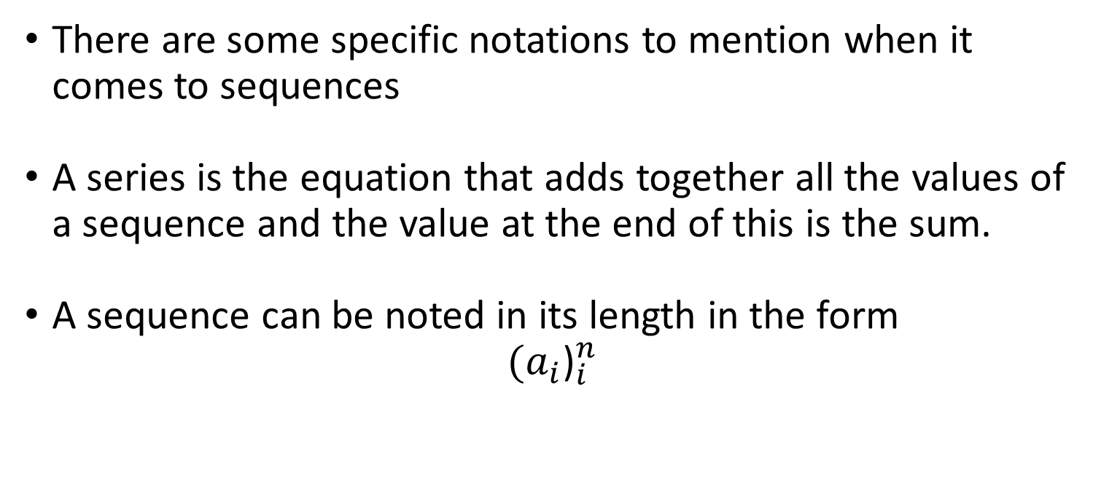
Sequences
There are some specific notations to mention when it comes to sequences
A series is the equation that adds together all the values of a sequence and the value at the end of this is the sum.
A sequence can be noted in its length in the form
$${(a_{i}\text{)}}_{i}^{n}$$

Slide 134
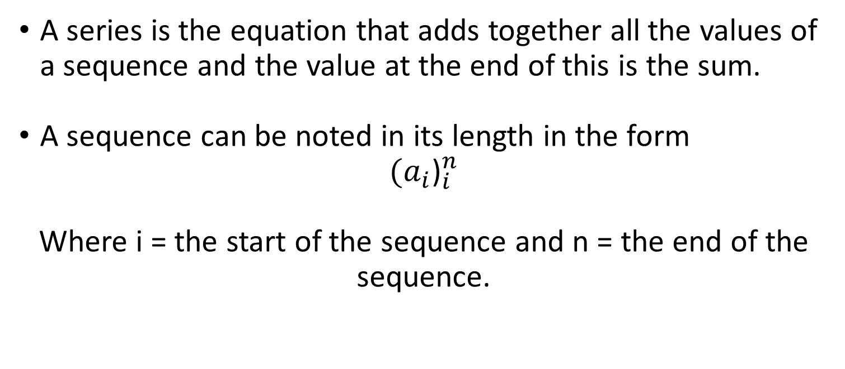
Sequences
A series is the equation that adds together all the values of a sequence and the value at the end of this is the sum.
A sequence can be noted in its length in the form
$${(a_{i}\text{)}}_{i}^{n}$$
Where i = the start of the sequence and n = the end of the sequence.

Slide 135
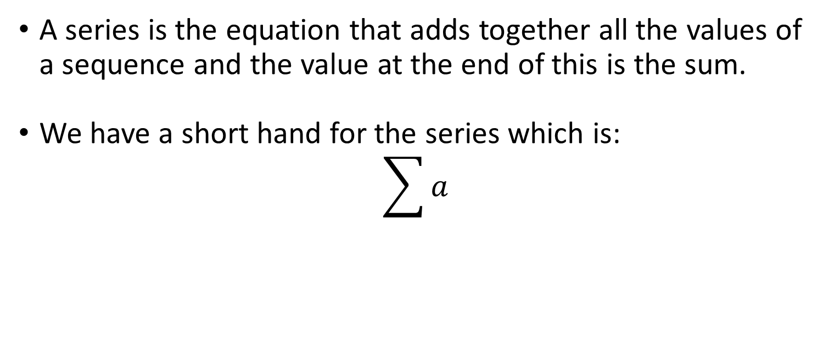
Sequences
A series is the equation that adds together all the values of a sequence and the value at the end of this is the sum.
We have a short hand for the series which is:
$$\sum{a}$$

Slide 136

Sequences
The series value i.e. the sum of a sequence a = 1,2,3,4 would be
$\sum{a}$ = 10

Slide 137
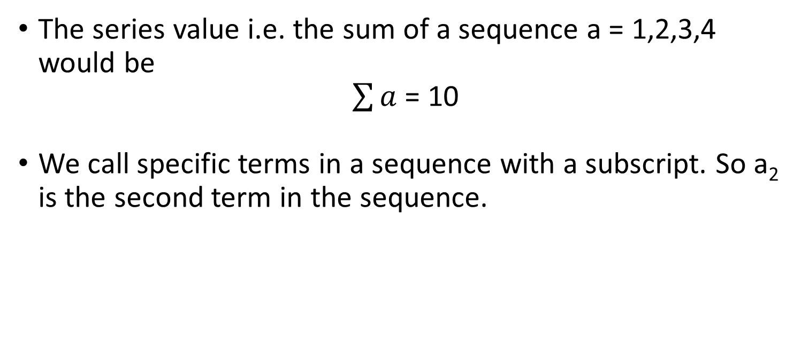
Sequences
The series value i.e. the sum of a sequence a = 1,2,3,4 would be
$\sum{a}$ = 10
We call specific terms in a sequence with a subscript. So a₂ is the second term in the sequence.

Slide 138
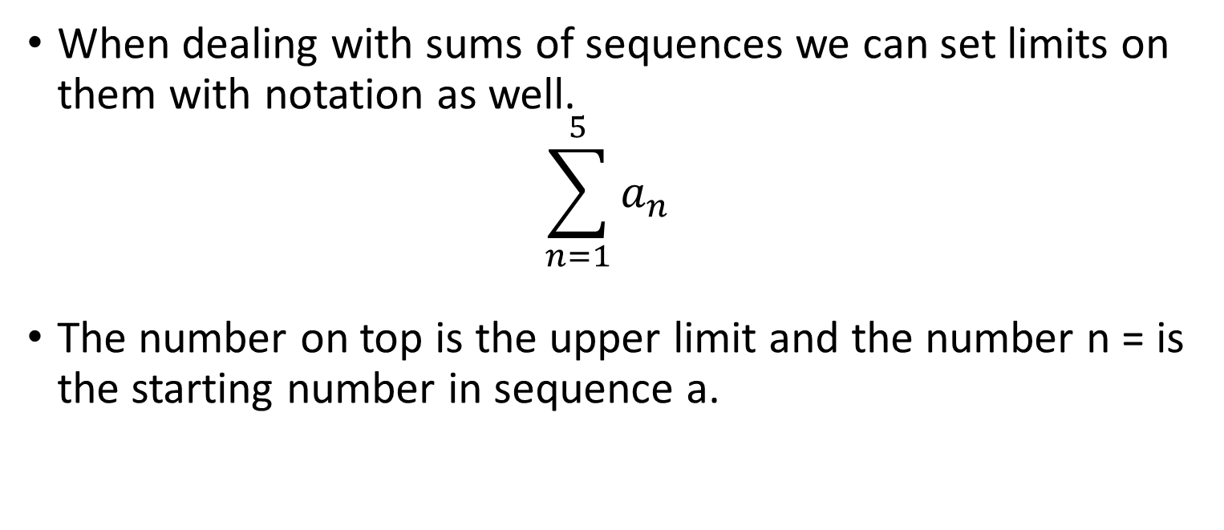
Sequences
When dealing with sums of sequences we can set limits on them with notation as well.
$$\sum_{n=1}^{5}{a_{n}}$$
The number on top is the upper limit and the number n = is the starting number in sequence a.

Slide 139

Sequences
$$\sum_{n=1}^{5}{a_{n}}$$
When sequence a = 1,2,3,4,5,6,7,8,9,10
The sum is from 1 to 5

Slide 140

Sequences
$$\sum_{n=1}^{5}{a_{n} =15}$$
When sequence a = 1,2,3,4,5,6,7,8,9,10
The sum is from 1 to 5

Slide 141
Sets
A set is an organised collection of distinct objects.
A sequence is a set of numbers.
There are lots of well known sets e.g. integers, natural numbers etc.

Slide 142
Sets
A set is written within { }, with the members of the set written within.
{1,5}
is a set that contains the numbers 1 and 5.
If a set follows a logical progression you can put … in it to show it continues:
{1,2,3,4,5…}
This is a set of integers.

Slide 143
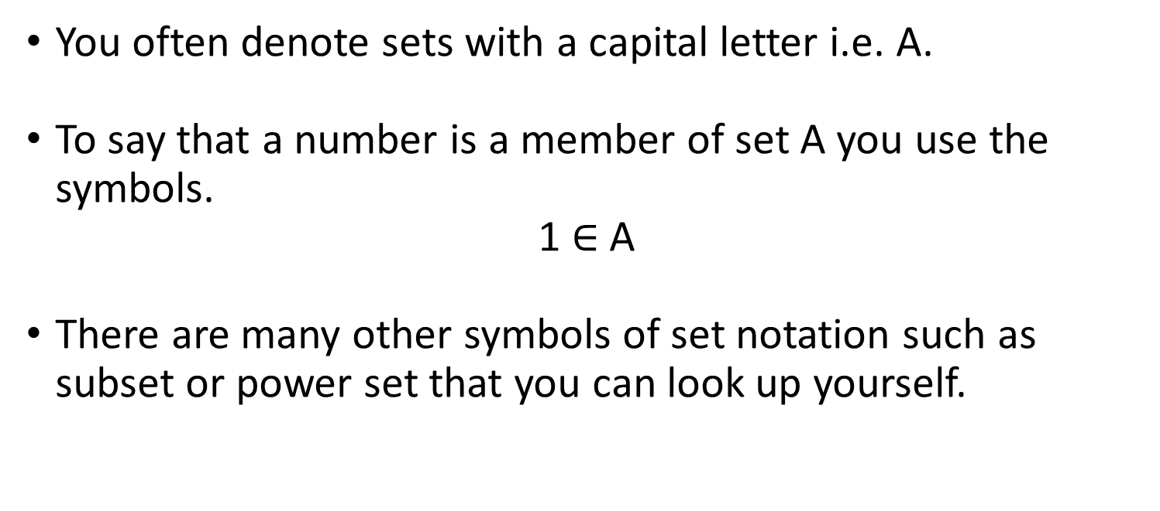
Sets
You often denote sets with a capital letter i.e. A.
To say that a number is a member of set A you use the symbols.
1 $∈$ A
There are many other symbols of set notation such as subset or power set that you can look up yourself.

Slide 144
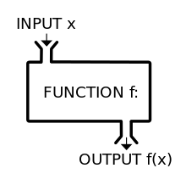
Functions
A function is merely something you apply to an input to get an output.

Slide 145
Functions
If you have a function for example x10 and – 13 this gets applied to any input you put in the function.

Slide 146
Functions
If you have a function for example x10 and – 13 this gets applied to any input you put in the function.
Functions are normally denoted f(x)
So in our example with x our input
f(x) = 10x - 13

Slide 147
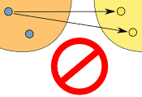
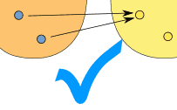
Functions
In functions an input can only have a single output, however multiple inputs can have the same output.
If these rules are broken it is a relationship and not a function.

Slide 148
Functions
The set of inputs of a function is called the domain.
The set of outputs of a function is called the codomain or target
You can apply a function to an entire set

Slide 149
Functions
Sometimes you may want to work out what a function of a function is, called a composite function.
If
f(x) = 2x + 1
g(x) = 4x
Find f(g(x))

Slide 150
Functions
f(x) = 2x + 1
g(x) = 4x
Find f(g(x))
2*(4x)+1

Slide 151
Functions
There are inverse function denoted f-1(x)
These are just the opposite of a function.

Slide 152
Functions
If:
f(x) = 4x+7
f-1(x) =

Slide 153
Functions
If:
f(x) = 4x+7
f-1(x) = x/4 – 7

Slide 154
Graphing Functions
You may have noticed a function is remarkably similar to our linear equations before.
f(x) = mx + c where the output is the y coordinate and the input is the x coordinate and you apply a linear function to it.

Slide 155
Graphing Functions
We can graph functions because after all they are just an output of a set of inputs.
If you think of this as set of y coordinates matching x coordinates it is a line.

Slide 156
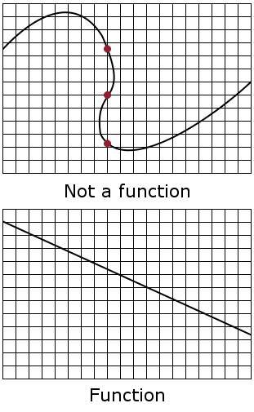
Graphing Functions
The key principle of a function was that a single input cannot have multiple outputs.
This means that in a graph of a function the line cannot have more than one y coordinate at the same x coordinate

Slide 157
Graphing Functions
Functions are graphed simply by plotting a series of inputs and outputs of the function.
With any algebraic formula we can put a set in. e.g x = 1 to x = 10 and pull out the y coordinates and put them into a graph.

Slide 158
Graphing Functions
Here is the linear equation we got from our simultaneous equations earlier.
y = 3.25x + 0.5
If we plot this equation we will get a straight line
We can plot it by putting in a set of numbers into it as a function.

Slide 159
Graphing Functions
Using the function f(x) = 3.25x + 0.5
x | y
-2 | -6
-1 | -2.75
0 | 0.5
1 | 3.75
2 | 7
3 | 10.25
4 | 14

Slide 160
Graphing Functions
Using the function f(x) = 3.25x + 0.5
x | y
-2 | -6
-1 | -2.75
0 | 0.5
1 | 3.75
2 | 7
3 | 10.25
4 | 14

